Slide 1

YouTube Comments Sentiment Analysis
Submitted By:
Aniket Adwankar (230343025002)
Vinay Gadade (230343025013)
Yashodhan Jagtap (230343025021)
Shubham Kumbhar (230343025029)
Guided By:
Mr. Anay Tamhankar.
Mr. Prasad Deshmukh.
28/08/2023
1

Slide 2
Index
Introduction
Problem Statement
Flowchart to Build Model
Technology Platform Used For Project
About the Dataset
Data Pre-Processing
Machine Learning Algorithms
Data Visualization & Representation
Conclusion

Slide 3
Introduction
Sentiment analysis, also referred to as opinion mining, is an approach to natural language processing (NLP) that identifies the emotional tone behind a body of text. This is a popular way for organizations to determine and categorize opinions about a product, service or idea.
YouTube comment sentiment analysis provides a deeper understanding of viewer opinions, emotions, and preferences.
It provides actionable insights for creators, marketers, administrators, researchers, and brands to enhance content strategies, engagement efforts, and decision-making processes.

Slide 4

Problem Statement
The goal of this project is to perform sentiment analysis on YouTube comments to classify them as positive, negative or neutral. The analysis should take into account the presence of emoji, which can contribute significantly to the sentiment of a comment. The project involves building a system that can handle YouTube comments, processing them and providing insights into the overall sentiment of the audience.

Slide 5
System Architecture
Data Source
Youtube API
(Python)
MongoDB
(PyMongo)
KAFKA
(Python)
Spark Algorithm for Sentiment Analysis
(Python)
Output table
(csv)
Visualization
In Tableu

Slide 6
Technology Used For Project
Python
MongoDB
Kafka
Spark
Machine Learning
Tableau

Slide 7
About the Dataset
Data fetched from YouTube .
There are more than 300000 observations and 3 variables.
Data size is 35MB.
Contains - YouTube Comments data of Alan Walker song video including comment_number, comment_text, name.

Slide 8
Data Pre-Processing
1) Cleaning the columns according to requirement
2) Dropping missing values.
3) Lowering the text.
4) Removing URL and unwanted regex.
5) Text tokenization.
6) Removing stop words.
6

Slide 9
Machine Learning Algorithms
NLP-
Natural Language Processing (NLP) in machine learning focuses on enabling computers to understand, interpret, and generate human language. NLP involves a wide range of tasks and techniques that allow machines to process, analyze, and generate text and speech in a way that is meaningful and contextually relevant.
NLP has numerous applications in various industries, including text analysis, language translation, sentiment analysis, speech recognition, and more.

Slide 10
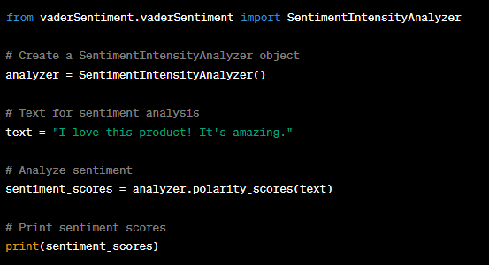
VADER-
"VADER," which stands for "Valence Aware Dictionary and sEntiment Reasoner”.
VADER is known for its effectiveness in analyzing the sentiment of text with a focus on social media language, which can be quite informal and filled with slang, emojis, and other non-standard language constructs. It can detect both the polarity (positive, negative, or neutral) and the intensity of sentiment in a given text.

Slide 11
Data Visualization & Representation

Slide 12
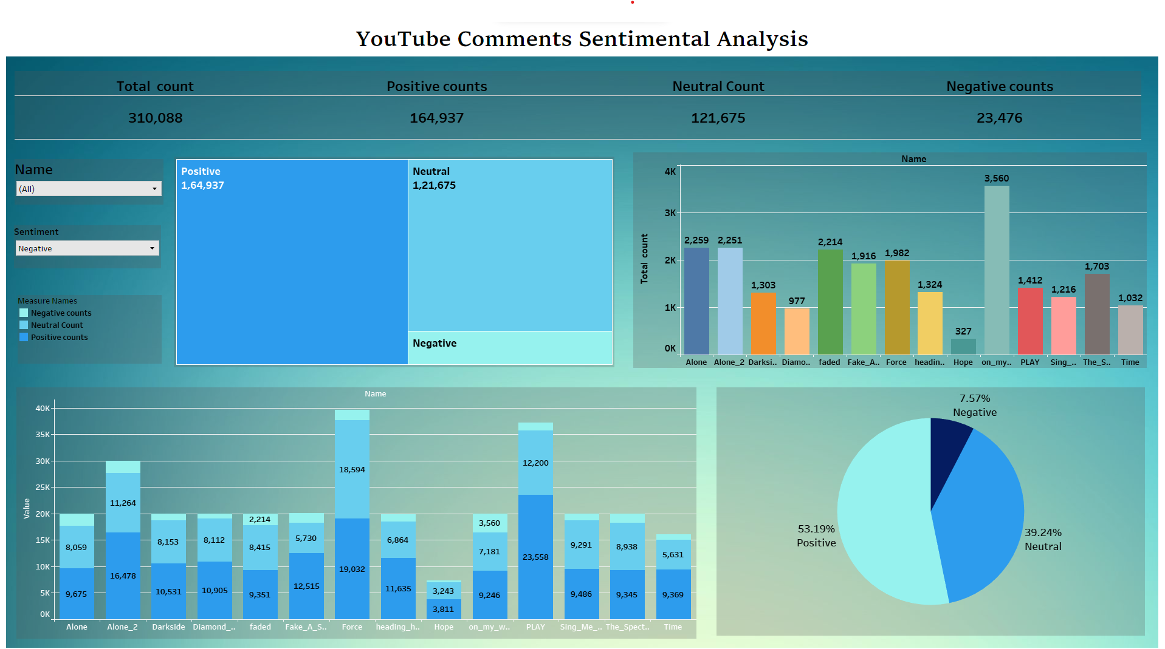
Dashboard

Slide 13
CONCLUSION
The successful execution of the "YouTube Comments Sentiment Analysis" project will empower content creators and YouTube administrators with data-driven insights into how their videos are perceived by the audience. This knowledge can lead to improved content strategies, increased user engagement, and enhanced overall user experience on the platform.

Slide 14
Future Scope
1.Multimodal Analysis: Incorporate other types of data, such as video views, likes, dislikes, and user demographics, for a more comprehensive analysis of viewer sentiment.
2.Real-Time Analysis: Develop real-time sentiment analysis systems that can process and respond to comments as they are posted on YouTube.
3.Improved Accuracy: Enhance sentiment analysis models using state-of-the-art NLP techniques, including deep learning and transformer-based models.
4.Topic Modelling: Extend analysis to identify common topics or themes in comments, providing deeper insights into viewer interests.
5.User Sentiment Profiles: Develop profiles of user sentiment over time to track changes in audience sentiment and preferences.
6.Content Recommendations: Use sentiment analysis to improve content recommendations on YouTube, helping users discover videos aligned with their sentiments and interests.

Slide 15
THANK YOU.

